Slide 1
Lecture 6: Telescopes and Spacecraft
Jupiter as seen by Cassini spacecraft
Claire Max
April 22, 2014
Astro 18: Planets and Planetary Systems
UC Santa Cruz

Slide 2
Class logistics
I fell behind on the reading assignments posted on the web. They are now all there. Sorry!
  Supplementary reading for those of you who know calculus is posted on the eCommons site
Homework due Thursday
  Includes optional problems involving calculus

Slide 3
Exams
Mid-Term:
  Thursday May 8th in class (noon to 1:45)
Final:
  Wednesday June 11th, 8am – 11am

Slide 4
People who added class late:
  Please see me during break at 12:45
  Thanks!

Slide 5
Topics for this lecture
Telescopes and spacecraft: how we learn about the planets
  Lenses
  Cameras and the eye
  Telescope basics (optical, x-ray, radio telescopes)
  Blurring due to atmospheric turbulence; adaptive optics
  Airborne telescopes
  Spacecraft

Slide 6
Telescopes: Main Points
Telescopes gather light and focus it
  Larger telescopes gather more light
  Telescopes can gather “light” at radio, infrared, visible, ultraviolet, x-ray, γ-ray wavelengths
Telescopes can be on ground, on planes, in space
If Earth’s atmosphere weren’t turbulent, larger ground-based telescopes would give higher spatial resolution
  Adaptive optics can correct for blurring due to turbulence
Every new telescope technology has resulted in major new discoveries and surprises

Slide 7
What are the two most important properties of a telescope?
Light-collecting area: Telescopes with a larger collecting area can gather a greater amount of light in a shorter time.
Angular resolution: Telescopes that are larger are capable of taking images with greater detail.

Slide 8
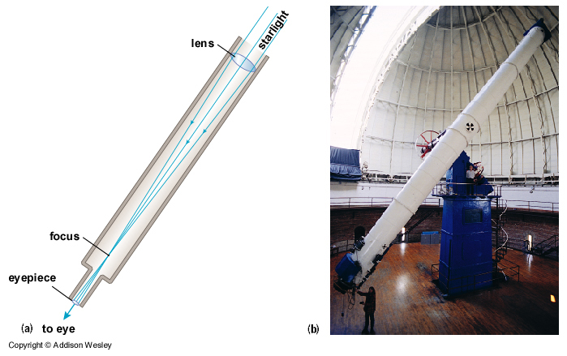
Telescopes gather light and focus it
Refracting telescope
Telescope as a “giant eye”
  You can gather more light with a telescope, hence see fainter objects

Slide 9
Amount of light gathered is proportional to area of lens
Why area?
“Size” of telescope is usually described by diameter d of its primary lens or mirror
Collecting area of lens or mirror = π r² = π (d/2)²
versus

Slide 10
Light-gathering power
Light-gathering power area = π (d/2)²
Eye:
  At night, pupil diameter ~ 7 mm, Area ~ 0.4 cm²
Keck Telescope:
  d = 10 meters = 1000 cm, Area = 7.85 x 10⁵ cm²
  Light gathering power is 1.96 million times that of the eye!

Slide 11
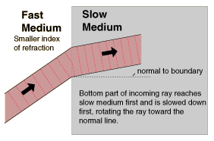
Refracting telescopes focus light using “refraction”
Speed of light is constant in a vacuum
But when light interacts with matter, it usually slows down a tiny bit
This makes “rays” of light bend at interfaces

Slide 12
Refraction animation
http://www.launc.tased.edu.au/online/sciences/physics/refrac.html

Slide 13
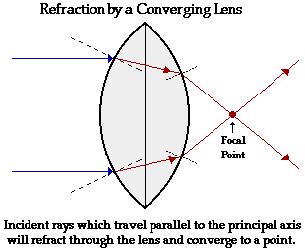
A lens takes advantage of the bending of light to focus rays
Focus – to bend all light waves coming from the same direction to a single point

Slide 14
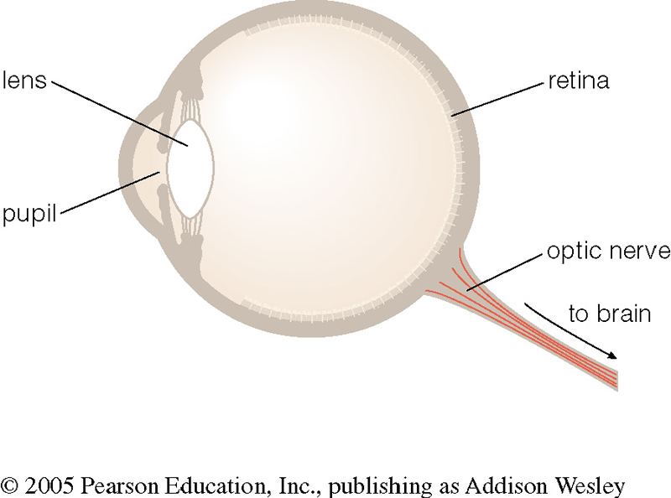
Parts of the Human Eye
pupil – allows light to enter the eye
lens – focuses light to create an image
retina – detects the light and generates signals which are sent to the brain
Camera works the same way: the shutter acts like the pupil and the film acts like the retina!

Slide 15
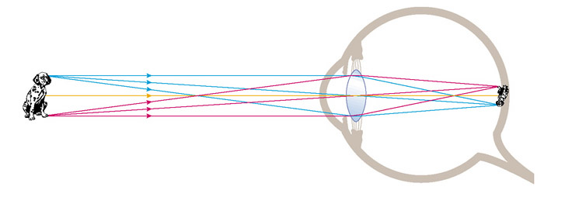
The lens in our eyes focuses light on the retina
Note that images are upside down!
Our brains compensate!

Slide 16
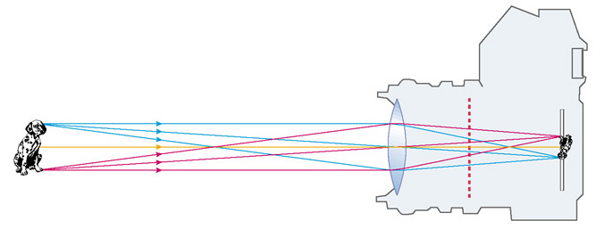
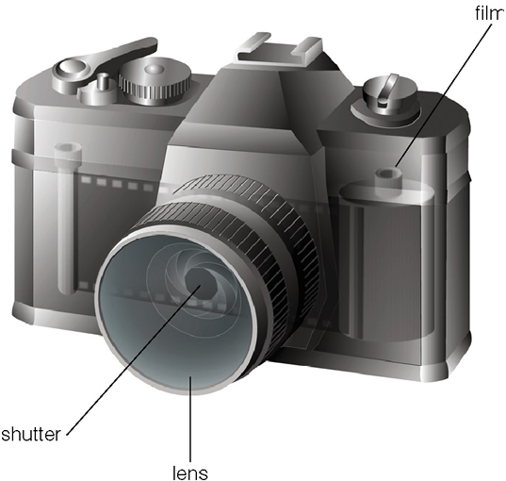
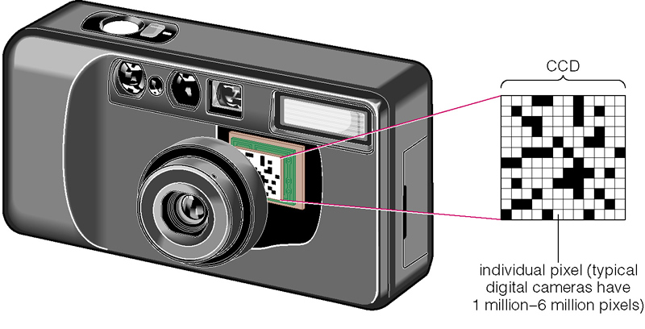
Camera lens focuses light on film or CCD detector
Upside down

Slide 17
What have we learned?
How does your eye form an image?
  It uses refraction to bend parallel light rays so that they form an image.
  The image is in focus if the focal plane is at the retina.
How do we record images?
  Cameras focus light like your eye and record the image with a detector.
  The detectors (CCDs) in digital cameras are like those used on modern telescopes

Slide 18
What are the two basic designs of telescopes?
Refracting telescope: Focuses light with lenses
Reflecting telescope: Focuses light with mirrors

Slide 19
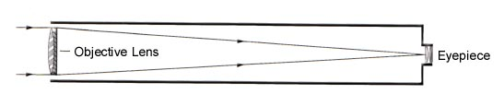
Cartoon of refracting telescope

Slide 20
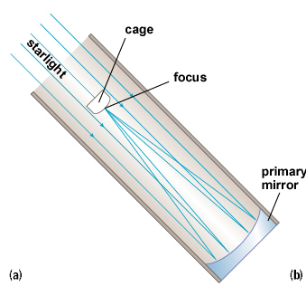
Telescopes can use mirrors instead of lenses to gather and focus light
For practical reasons, can’t make lenses bigger than ~ 1 meter
Can make mirrors much larger than this
  Largest single telescope mirrors today are about 8.5 m
Old-fashioned reflecting telescope:
  Observer actually sat in “cage” and looked downward

Slide 21
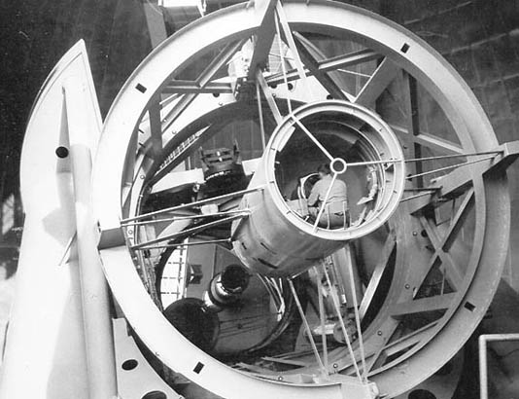
Mount Palomar (near San Diego): Prime focus cage and an inhabitant
"NOTE: Smoking and drinking are not permitted in the prime focus cage" (On web page of Anglo Australian Telescope)
Until the 1970’s, women weren’t permitted either!
Looking down the telescope tube from the top. Mirror is at the bottom.

Slide 22
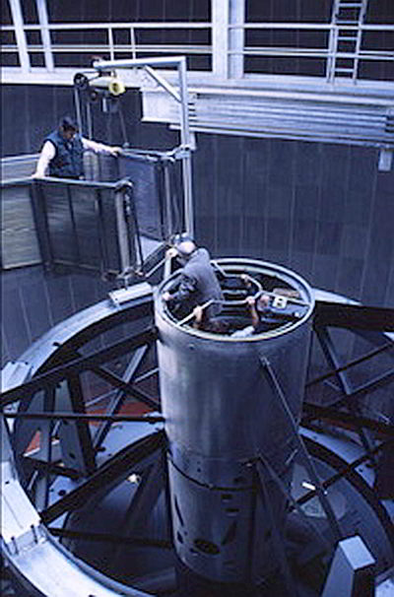
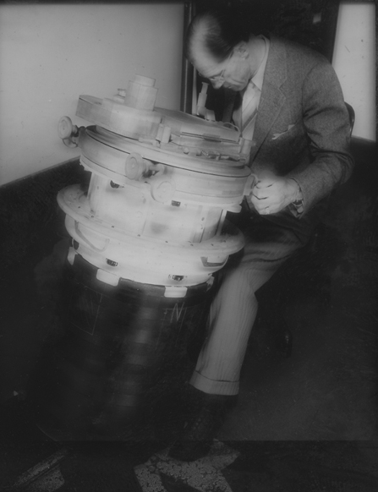
More photos of Prime Focus Cage: things really have gotten better!

Slide 23
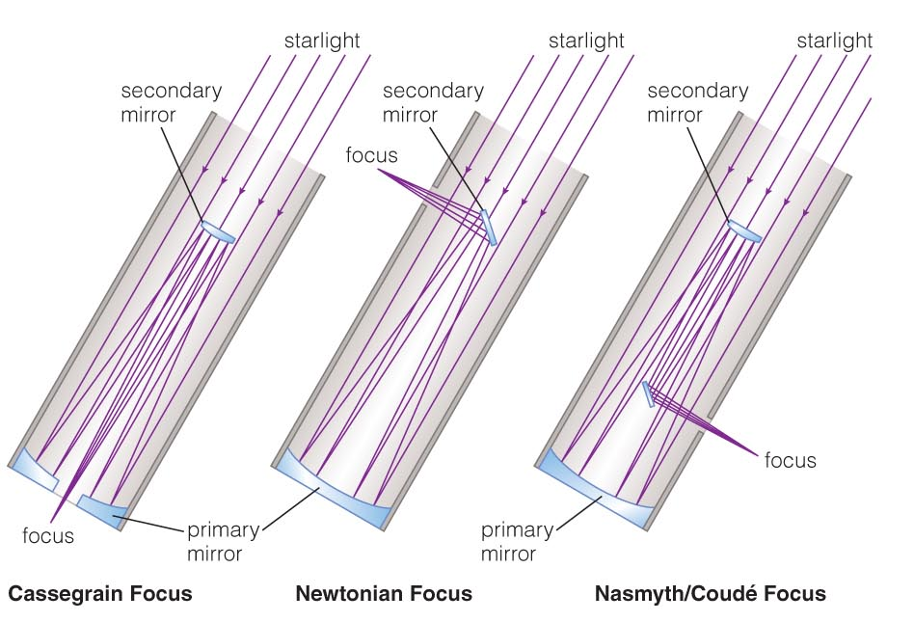
Designs for Reflecting Telescopes

Slide 24
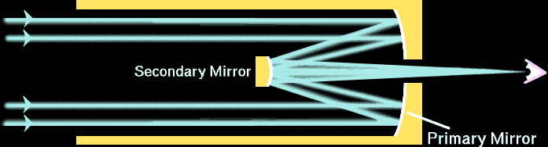
Most of today’s reflecting telescopes use Cassegrain design
Light enters from top
Bounces off primary mirror
Bounces off secondary mirror
Goes through hole in primary mirror to focus

Slide 25
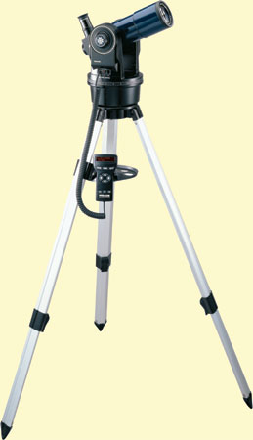
Examples of real telescopes
Backyard telescope:
  3.8” diameter refracting lens
  Costs ~ $300 at Amazon.com
  Completely computerized: it will find the planets and galaxies for you

Slide 26
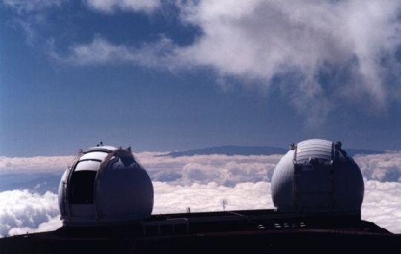
Largest optical telescopes in world
Twin Keck Telescopes on top of Mauna Kea volcano in Hawaii

Slide 27
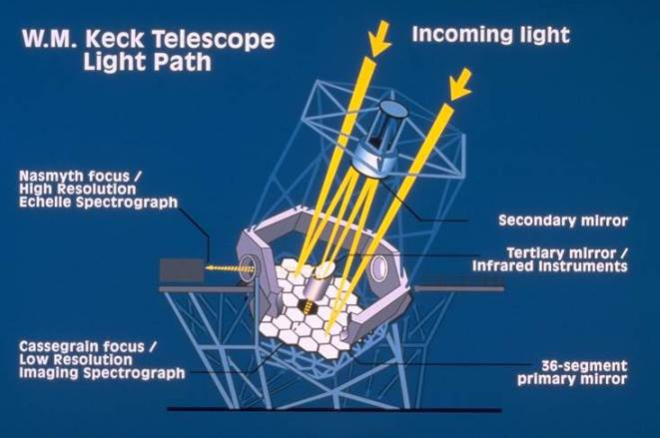
36 hexagonal segments make up the full Keck mirror

Slide 28
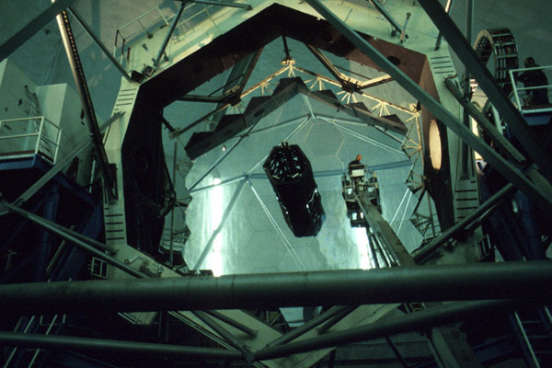
Cleaning the Keck’s 36 segments

Slide 29
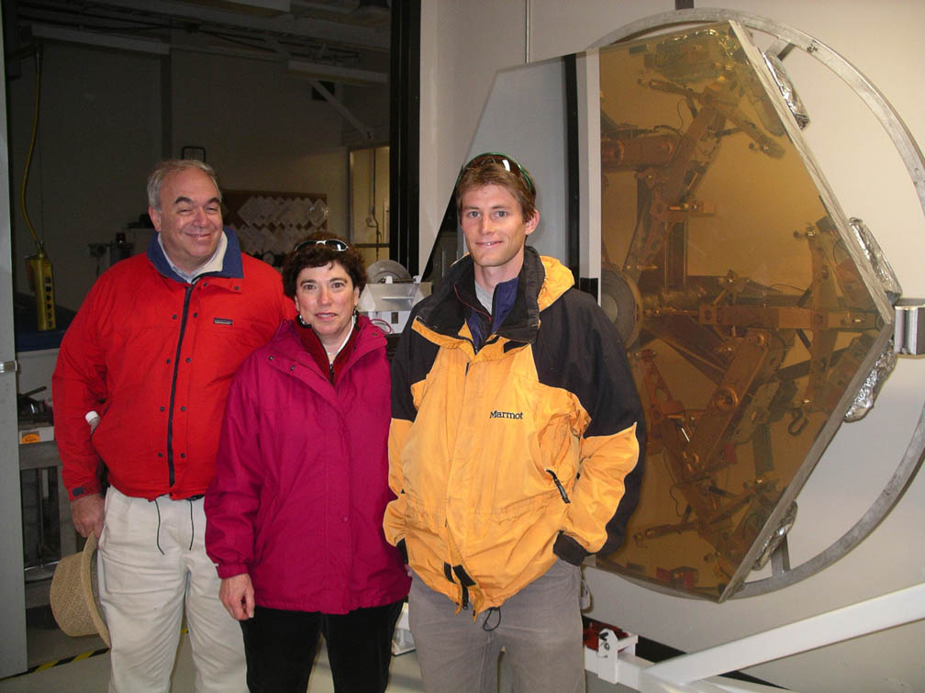
One Keck segment (in storage)

Slide 30
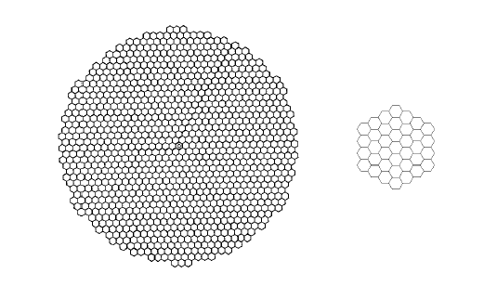
Future plans are even more ambitious
Thirty Meter Telescope Keck Telescope

Slide 31
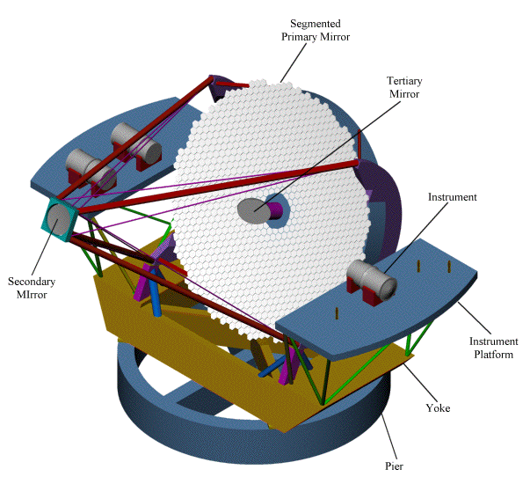
Future plans are even more ambitious
People!

Slide 32
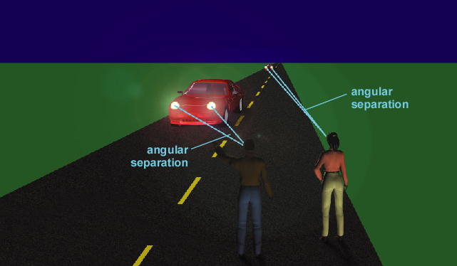
Concept of angular resolution
Car Lights
Angular resolution
The ability to separate two objects.
The angle between two objects decreases as your distance to them increases.
The smallest angle at which you can distinguish two objects is your angular resolution.

Slide 33
How big is one "arc second" of angular separation?
A full circle (on the sky) contains 360 degrees or 2π radians
  Each degree is 60 arc minutes
  Each arc minute is 60 arc seconds

Slide 34
What does it mean for an object to “subtend an angle Θ” ?
Your eye
Angle Θ
A distant object
Θ is the apparent angular size of the object

Slide 35
“Small angle formula”
sin Θ ~ Θ if Θ is << 1 radian
s = d sin Θ ~ d Θ
Example: how many arc sec does a dime subtend if it is located 2 km away?
θ
s
d

Slide 36
Concept Question
From Earth, planet A subtends an angle of 5 arc sec, and planet B subtends an angle of 10 arc sec. If the radius of planet A equals the radius of planet B, then
a) planet A is twice as big as planet B.
b) planet A is twice as far as planet B.
c) planet A is half as far as planet B.
d) planet A and planet B are the same distance.
e) planet A is four times as far as planet B.

Slide 37
What do astronomers do with telescopes?
Imaging: Taking (digital) pictures of the sky
Spectroscopy: Breaking light into spectra
Timing: Measuring how light output varies with time

Slide 38
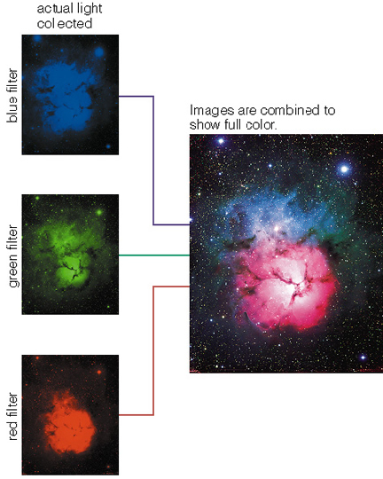
Imaging
Filters are placed in front of a camera to allow only certain colors through to the detector
Single color images are then superimposed to form true color images.
Notes:
Insert Fig. 7.12 on this slide. Animate with “blinds horizontal”.

Slide 39
How can we record images of nonvisible light?
  Electronic detectors such as CCDs can record light our eyes can't see
    Infrared light, ultraviolet light, even x-rays
  We can then represent the recorded light with some kind of color coding, to reveal details that would otherwise be invisible to our eyes

Slide 40
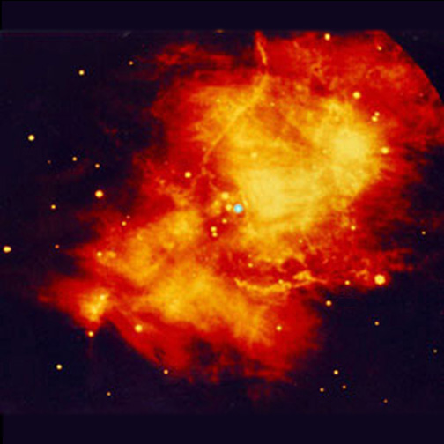
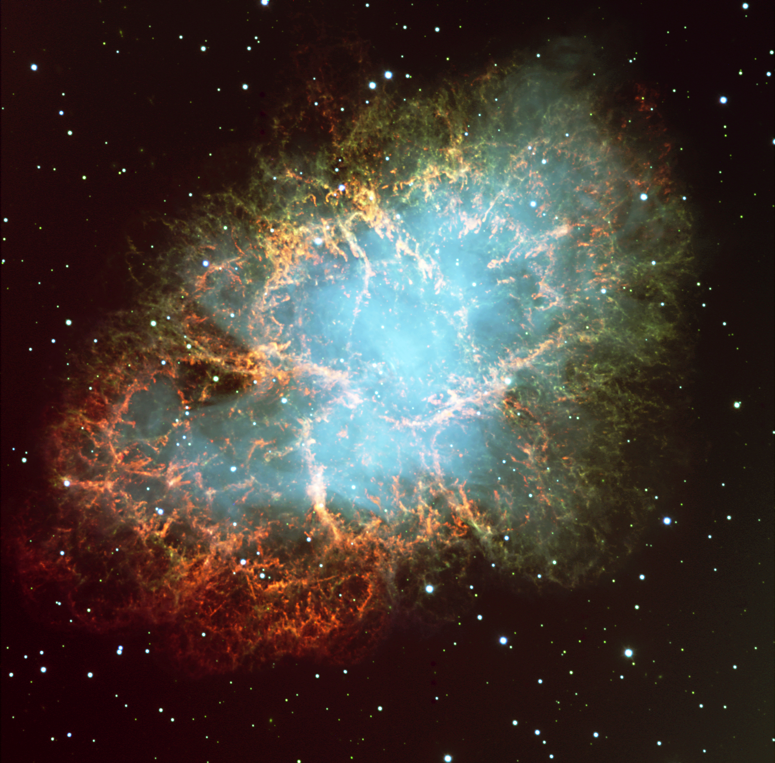
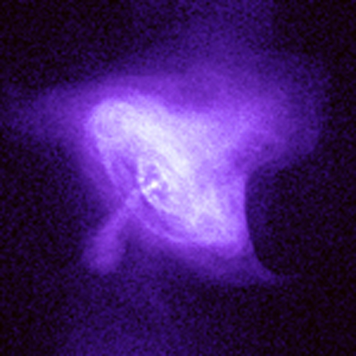
"Crab Nebula" - supernova remnant where a star blew up 1000 yrs ago
From above the atmosphere
Infra-red light
Visible light
X-rays

Slide 41
In principle, larger telescopes should give sharper images
Concept of “diffraction limit”
  Smallest angle on sky that a telescope can resolve
  Numerically:
In same units!

Slide 42
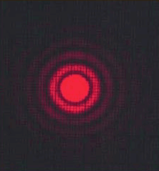
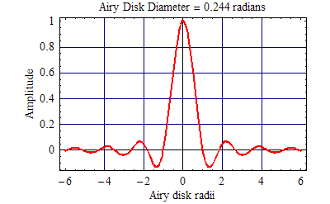
Image of a point source seen through a circular telescope mirror
At the “diffraction limit”, size of central spot ~ λ / D
Diffraction limit animation

Slide 43
Example of diffraction limit
Keck Telescope, visible light
BUT: Turbulence in the Earth’s atmosphere blurs images, so even the largest telescopes can’t “see” better than about 1 arc second
  A decrease of a factor of 1 / 0.0125 = 80 in resolution!

Slide 44
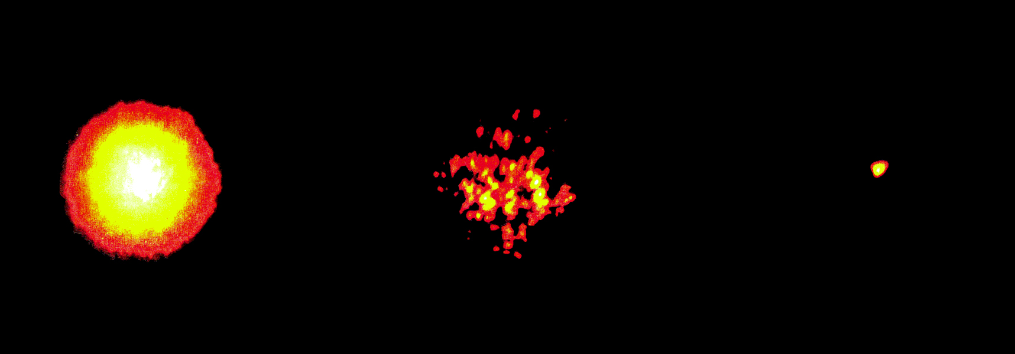
Images of a bright star, Arcturus
Lick Observatory, 1 m telescope
Long exposure
image
Short exposure
image
Diffraction limit of telescope

Slide 45
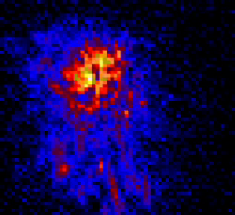
Snapshots of turbulence effects,
Lick Observatory
These are all images of a star, taken with very short exposure times (100 milliseconds)

Slide 46
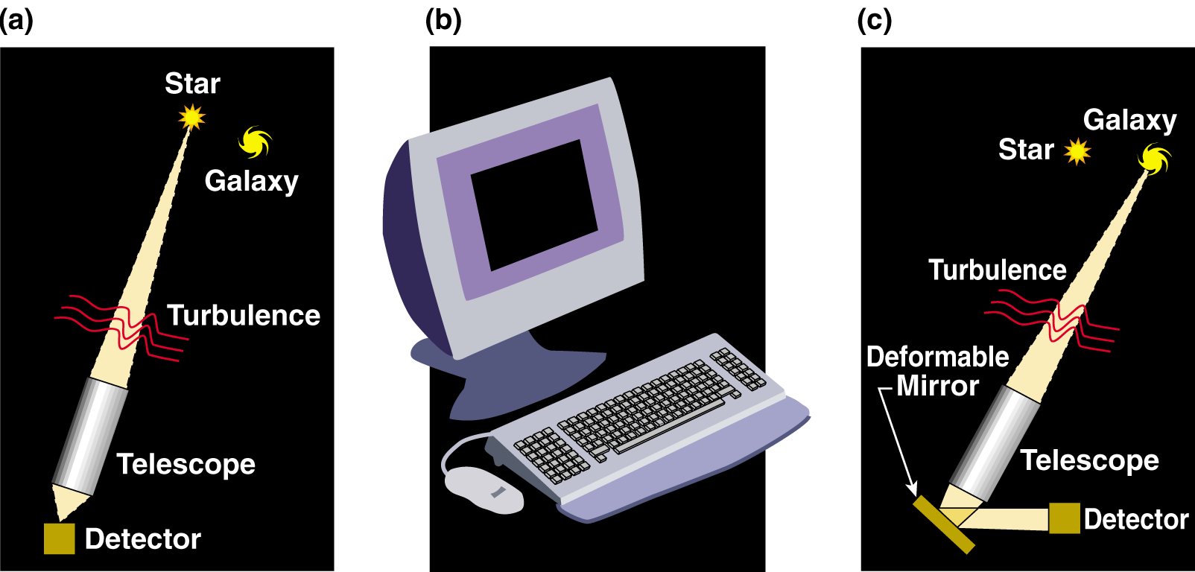
How to correct for atmospheric blurring
Measure details of blurring from “guide star” near the object you want to observe
Calculate (on a computer) the shape to apply to deformable mirror to correct blurring
Light from both guide star and astronomical object is reflected from deformable mirror; distortions are removed

Slide 47
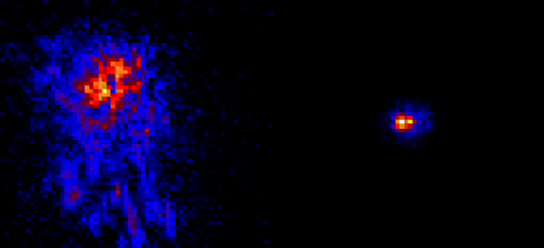
Infra-red images of a star, from Lick Observatory adaptive optics system
No adaptive optics
With adaptive optics

Slide 48
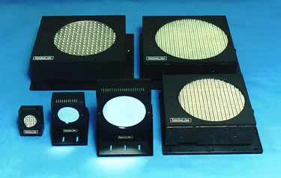
Deformable mirror is small mirror behind main mirror of telescope

Slide 49
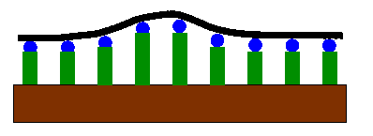
Mirror changes its shape because actuators push and pull on it
Actuators are glued to back of thin glass mirror
When you apply a voltage to an actuator, it expands or contracts in length, pushing or pulling on the mirror

Slide 50
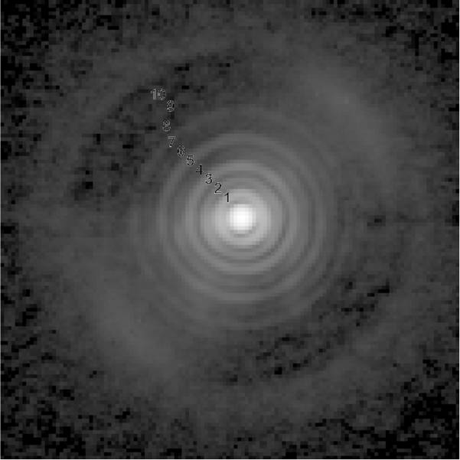
Image of a point source seen through a circular telescope mirror
At the “diffraction limit”, size of central spot ~ λ / D
Diffraction limit animation
LBT Telescope
with Adaptive Optics

Slide 51
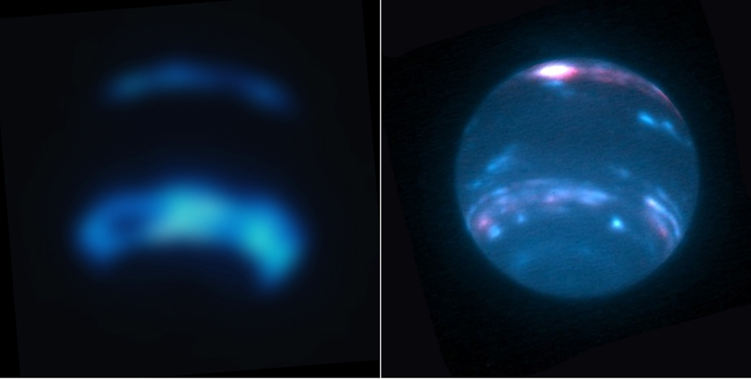
Neptune in infra-red light,
Keck Telescope adaptive optics
Without adaptive optics
With adaptive optics
2.3 arc sec

Slide 52
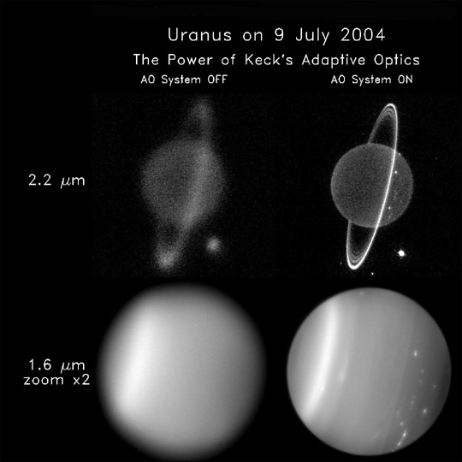

Slide 53
Concept Question
The Keck Telescope in Hawaii has a diameter of 10 m, compared with 5 m for the Palomar Telescope in California. The light gathering power of Keck is larger by a factor of
  2 b) 4 c) 15 d) 50
By what factor is Keck’s angular resolution better than that of Palomar, assuming that both are using their adaptive optics systems?
  2 b) 4 c) 15 d) 50

Slide 54
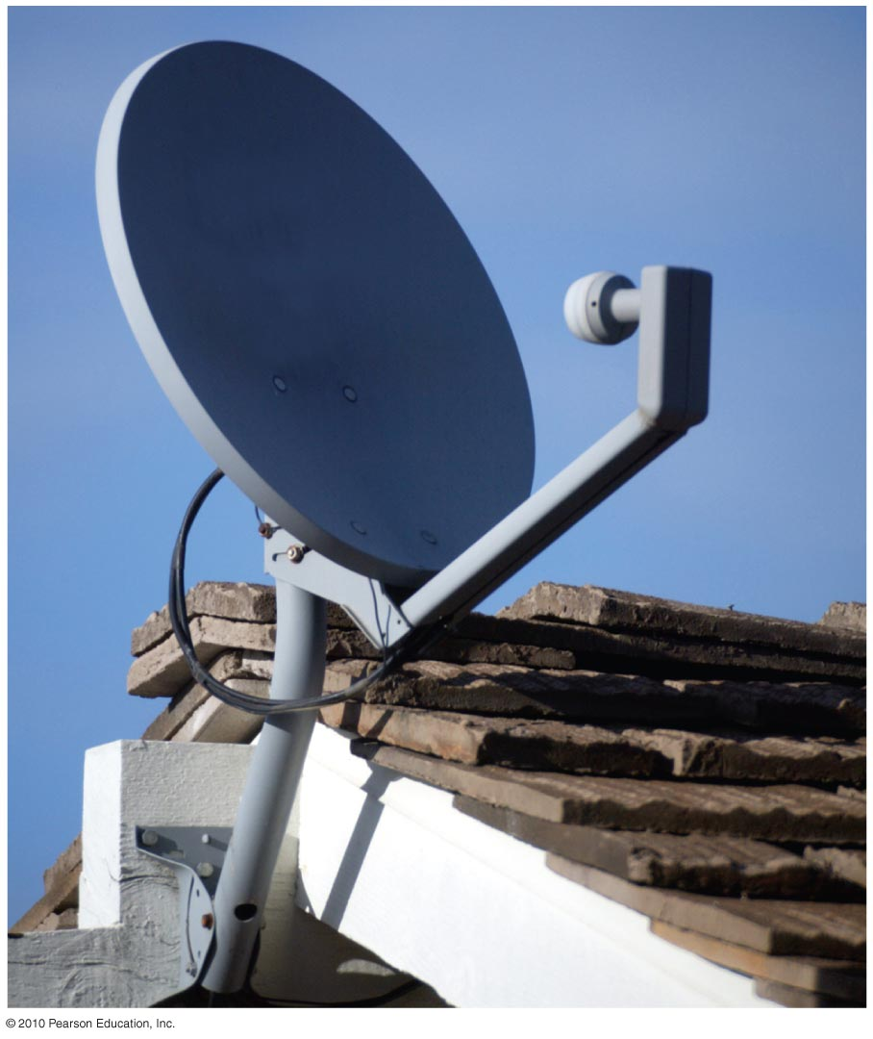
How can we observe invisible light?
A standard satellite dish is just a reflecting telescope for observing radio waves.

Slide 55
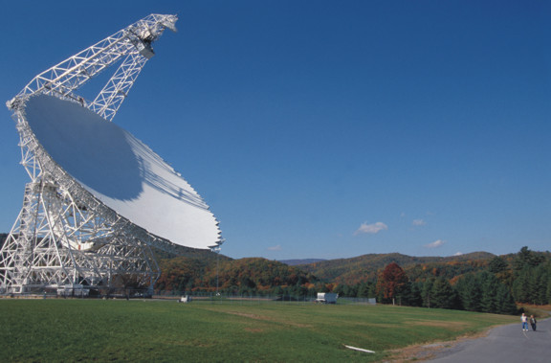
Reflecting telescopes work fine at radio wavelengths too
The radio telescope at Green Bank, NC

Slide 56
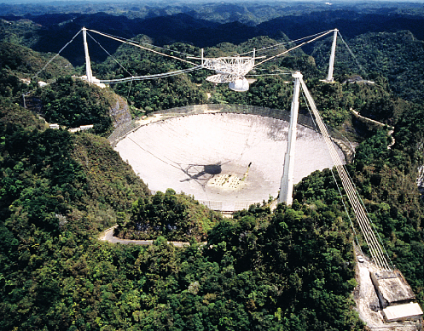
Largest radio telescope fills a whole valley in Puerto Rico
Arecibo Observatory

Slide 57
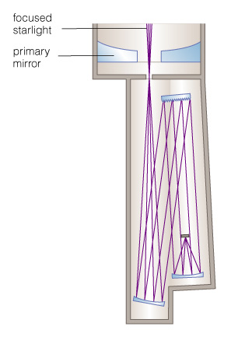
Spectroscopy
A spectrograph separates the different wavelengths of light before they hit the detector
Diffraction
grating breaks
light into
spectrum
Light from
a star
enters
Detector
records
spectrum

Slide 58
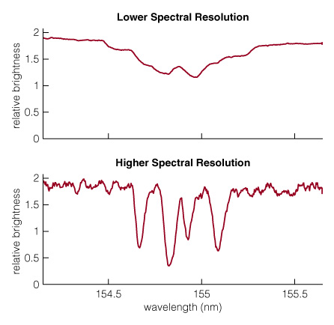
Spectroscopy and the effect of spectral resolution
Graphing relative brightness of light at each wavelength shows the details in a spectrum
Higher spectral resolution = more detail as a function of wavelength

Slide 59
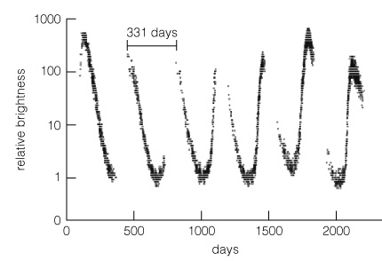
Timing
A light curve represents a series of brightness measurements made over a period of time

Slide 60
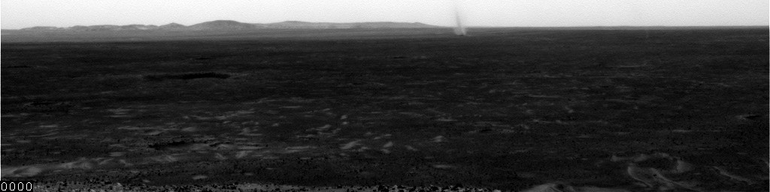
Timing: Dust devils on Mars seen from Spirit Rover

Slide 61
Want to buy your own telescope?
Buy binoculars first (e.g. 7x35) - you get much more for the same money.
Ignore magnification (sales pitch!)
Notice: aperture size, optical quality, weight and portability.
Product reviews: Astronomy, Sky & Telescope, Mercury Magazines. Also amateur astronomy clubs.
(Probably best to avoid cheap telescopes that you see in department stores or Big Box stores)
Notes:
Optional if you wish to discuss buying your own telescope; also point students to Special Topic box on p. 124.

Slide 62
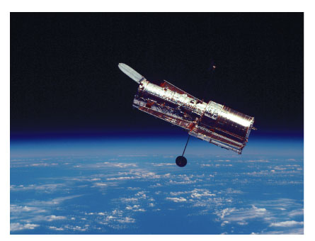
Why do we need telescopes in space?

Slide 63
Why do we need telescopes in space?
Some wavelengths of light don’t get through the Earth’s atmosphere
  Gamma-rays, x-rays, far ultraviolet, long infrared wavelengths
Going to space is a way to overcome blurring due to turbulence in Earth’s atmosphere
Planetary exploration: spacecraft can actually go to the planets, get close-up information

Slide 64
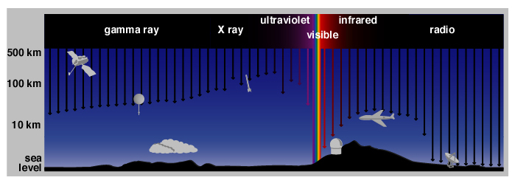
Depth of light penetration into atmosphere at different wavelengths

Slide 65
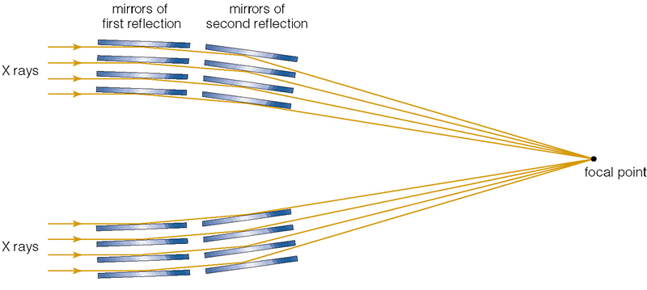
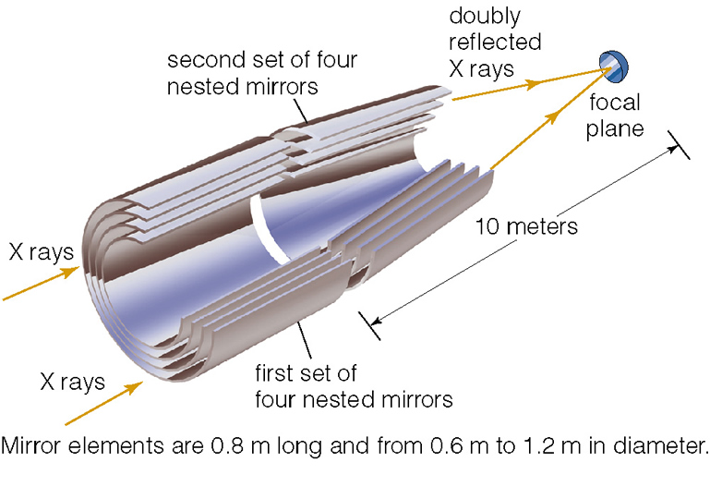
X-ray mirrors also concentrate light and bring it to a focus
X-ray mirrors

Slide 66
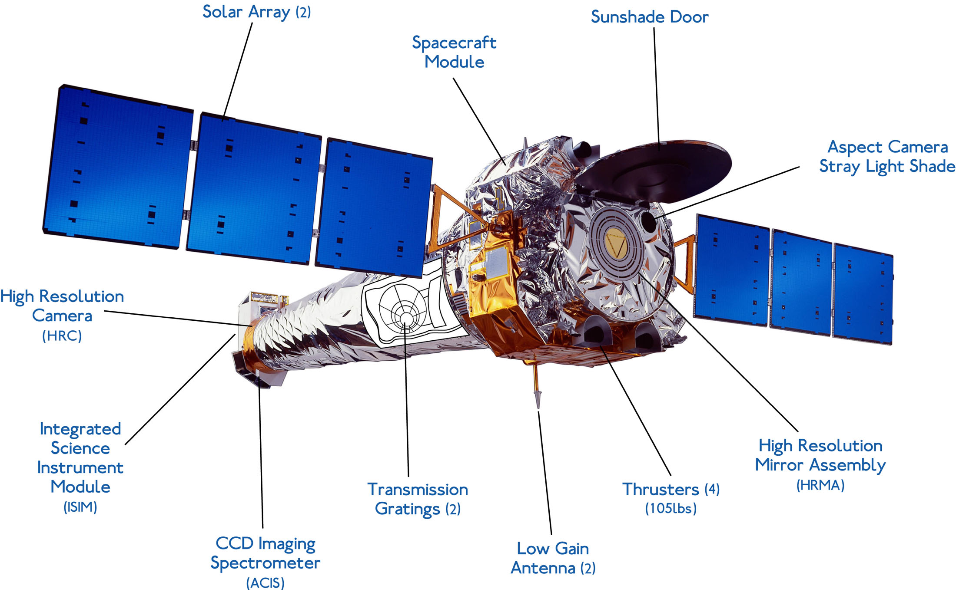
Chandra spacecraft: x-ray telescope

Slide 67
Types of space missions
Earth orbiters
  Hubble, Chandra space telescopes
Planetary fly-bys
  Mercury, Venus, Mars, Jupiter, Saturn, Uranus, Neptune so far
  New Horizons flyby of Pluto arrives there July 14 2015
Planetary orbiters
  Venus, Mars, Jupiter, Saturn so far.
  Soon: Mercury Messenger March 2011
Probes and landers
  Mars rovers: Spirit and Opportunity
  Mars landers: e.g. Phoenix
  Probes sent from orbiters of Venus, Mars, Jupiter
  Titan lander (Huygens probe from Cassini spacecraft)

Slide 68
Space missions carry telescopes, other instruments as well
Typically planetary fly-bys and orbiters carry small telescopes
  If you are close, you don’t need super-big telescope to get good angular resolution
Other instruments:
  Particle analyzers, radio antennae, spectrographs, laser altimeters, dust detectors, .....
  Mars rovers: probes to get rock samples and analyze them

Slide 69


Hubble Space Telescope: clearer vision above atmospheric turbulence
Hubble can see UV light that doesn’t penetrate through atmosphere

Slide 70

Example of robotic planet exploration: Galileo mission to Jupiter
(Artist's conception)

Slide 71



Spirit Rover on Mars

Slide 72
Concept Question
You are trying to decide whether to observe a new comet from a 10m telescope on the ground (without adaptive optics), or from the Hubble Space Telescope (diameter 2.4m).
Which of the following would be better from the ground, and which from space
Ability to make images in ultraviolet light
Spatial resolution of images in infrared light
Ability to record images of a very faint (distant) comet

Slide 73
Telescopes: The Main Points
Telescopes gather light and focus it
Telescopes can be on ground, on planes, in space
If Earth’s atmosphere weren’t turbulent, larger telescopes would give higher spatial resolution
  Adaptive optics can correct for blurring due to turbulence
Every new telescope technology has resulted in major new discoveries and surprises

